Slide 1

ORTEC
Software development
Balanced decision making
Daniel Craciun
Beniamin Dincuta

Slide 2

Agenda
01
Introduction
02
ORTEC for Field Service
03
Architecture
04
Development
05
Security & authentication

Slide 3




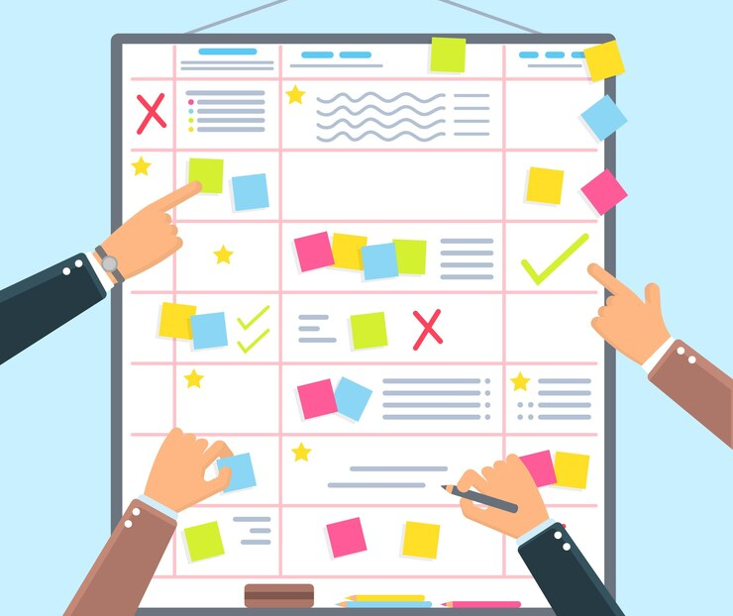
ORTEC for Field Service Road to the Cloud
Cloud-Native
Architected to exploit the advantages of cloud computing platforms in terms of scalability and elasticity
Virtualization
Virtualization, including managed services offerings, allows business to focus on their core activities and not IT
Client-Server
With a client-server architecture, next steps could be taken in sharing, scaling and optimization
Local Desktop
The first products allowed users to plan and optimize from a desktop computer
Plan Board
It all started (in a cave) on a wall with people gathered around a plan board

Slide 4





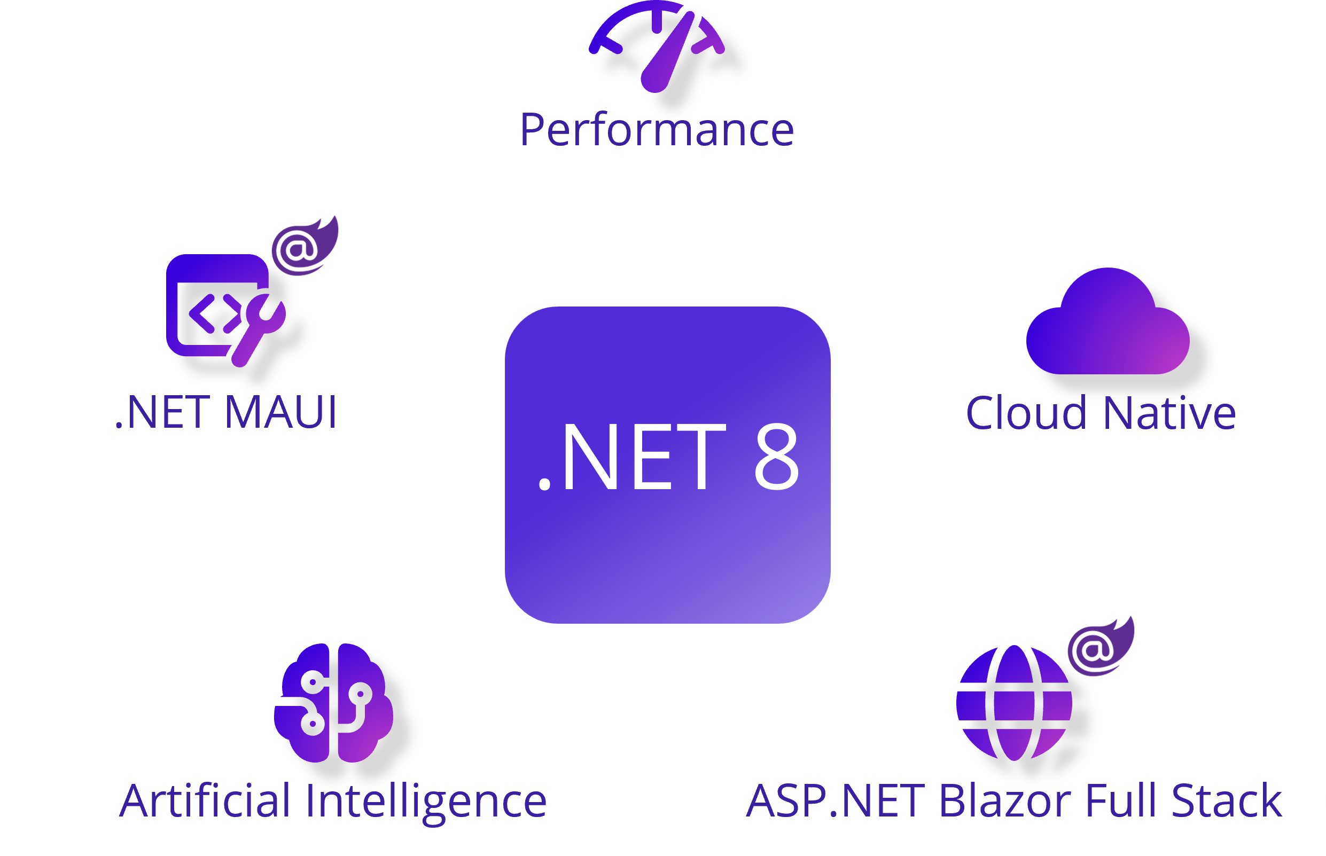


Technologies

Slide 5
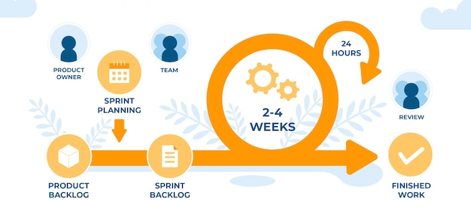
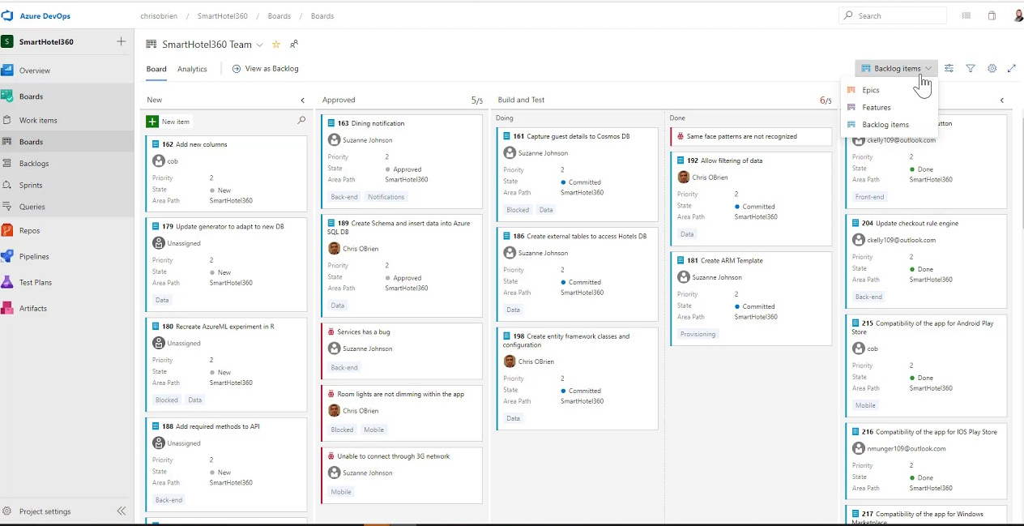
How do we organize it?
Project methodologies
Waterfall or agile?
Scrum, kanban, scrumban, etc.
Values: commitment, focus, openness, respect, and courage

Slide 6

Exercise how to balance decision making
You are part of the Scrum Team responsible for planning the first 3 sprints of the new, cloud‑native successor to our legendary product (ORTEC Field ).
Goals:
Migrate as many of our existing customers as possible (many have heavy customizations).
Build a lean, attractive product for new customers.
Deliver value quickly, balancing pixel‑perfect quality vs speed to market.
Sprint capacity: Max 20 story points per sprint — choose wisely.

Slide 7
Story ID | Description | Type | Points | Value: Old Customers | Value: New Customers | Notes
S1 | Migrate advanced dispatch customization | Old | 13 | High | Low | Complex refactor
S2 | Build real-time analytics dashboard | New | 8 | Medium | High | Attractive to modern buyers
S3 | Redesign UI for pixel-perfect consistency | Eng | 10 | Medium | High | Delays launch
S4 | Implement core routing engine in cloud | Both | 8 | High | High | Foundation
S5 | Add quick setup wizard | New | 5 | Low | High | Speeds onboarding
S6 | Support legacy data import formats | Old | 8 | High | Low | Makes migration possible
S7 | Optimize load times below 2s | Eng | 6 | Medium | High | Improves UX
S8 | Provide basic mobile app for deliveries | New | 7 | Medium | High | Differentiator

Slide 8
Rules and Mission
Rules:
Max 20 points per sprint
Must plan 3 consecutive sprints
Aim to balance Old vs New customer value
Deliver enough features to attract the market and keep existing customers happy
Decide how pixel‑perfect you need to be vs how fast you ship
Agile Values to Apply:
Customer collaboration over contract negotiation
Responding to change over following a plan
Working software over comprehensive documentation
Individuals & interactions over processes & tools
Your Mission (20–25 min):
Review backlog & constraints.
Plan the first 3 sprints (max 20 pts each).
Balance technical excellence & humanity (legacy respect + market appeal).
Prepare a 2-minute pitch covering:
Sprint plan table
Trade-offs you made
Which Agile values guided decisions
How you addressed pixel-perfect vs fast-to-market

Slide 9
Closing slide - Logo

